Slide 1

Business manager
Webex Training Series

Slide 2

Training overview
Todays Topics
-Exploring Diocese of Fall River Website
-Filing/QBO Backup
-Employee Files & Chancery forms

Slide 3

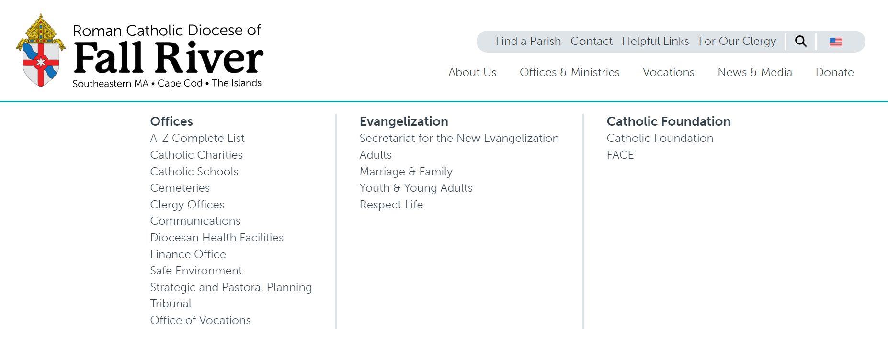
Diocesan website
https://www.fallriverdiocese.org/
Important pages:

Slide 4
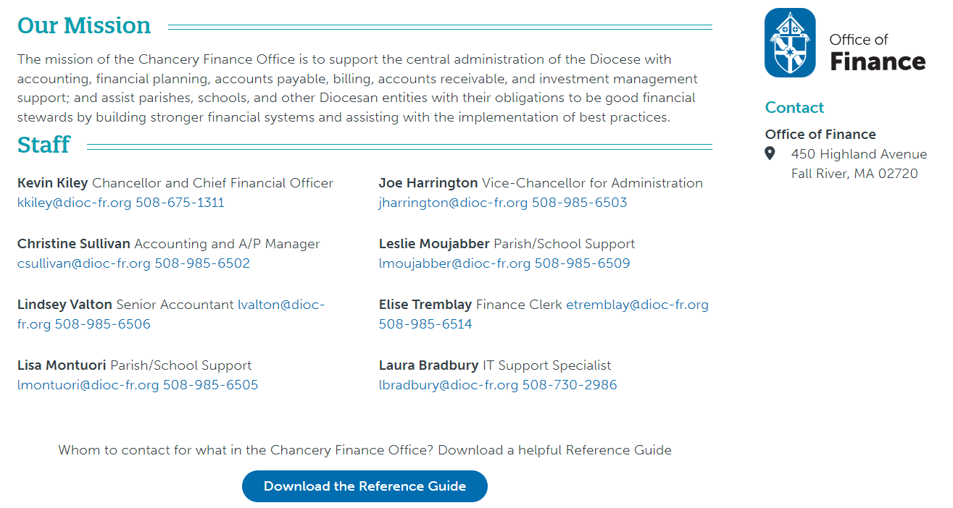

Slide 5
Review these Three sections:

Slide 6


Filing
Folders should be organized alphabetically and by vendor. The most recent invoice filed in front.
Invoice should be attached to check stub
Expense reimbursement form attached to reimbursement pay stub
Reconciliation folder for each month:
  Printed reconciliation from QBO
  Deposits for the month
  Bank statements for the month

Slide 7
Payroll retention policy
Permanent earnings and records |  | Termination +7 years |  | Paper or Electronic |  | Onsite or Offsite |  | (Paper) Secure shredding
Attendance records |  | Termination +7 years |  | Paper or Electronic |  | Onsite or Offsite |  | (Paper) Secure shredding
Employee contracts |  | Termination +7 years |  | Paper or Electronic |  | Onsite or Offsite |  | (Paper) Secure shredding
Employee deduction authorization |  | Termination +7 years |  | Paper or Electronic |  | Onsite or Offsite |  | (Paper) Secure shredding
Employee salary schedules |  | Termination +7 years |  | Paper or Electronic |  | Onsite or Offsite |  | (Paper) Secure shredding
W-2 year end forms |  | Filing + 7 years |  | Paper or Electronic |  | Onsite or Offsite |  | (Paper) Secure shredding
W-4 year end forms |  | Filing + 7 years |  | Paper or Electronic |  | Onsite or Offsite |  | (Paper) Secure shredding
Time cards |  | Termination + 7 years |  | Paper or Electronic |  | Onsite or Offsite |  | (Paper) Secure shredding
Payroll journals or registers |  | 7 years |  | Paper or Electronic |  | Onsite or Offsite |  | (Paper) Secure shredding
Employment taxes (contributions and payments) |  | Filing + 7 years |  | Paper or Electronic |  | Onsite or Offsite |  | (Paper) Secure shredding

Slide 8
Banking retention policy
Bank deposits |  | 7 years |  | Paper or Electronic |  | Onsite or Offsite |  | (Paper) Secure shredding
Bank statements |  | 7 years |  | Paper or Electronic |  | Onsite or Offsite |  | (Paper) Secure shredding
Cancelled checks |  | 7 years |  | Paper or Electronic |  | Onsite or Offsite |  | (Paper) Secure shredding
Check registers/stubs |  | 7 years |  | Paper or Electronic |  | Onsite or Offsite |  | (Paper) Secure shredding

Slide 9
other retention policy
Accounts payable, invoices |  | 7 years |  | Paper or Electronic |  | Onsite or Offsite |  | (Paper) Secure shredding
Accounts payable, ledgers |  | 7 years |  | Paper or Electronic |  | Onsite or Offsite |  | (Paper) Secure shredding
Accounts receivable, ledgers |  | 7 years |  | Paper or Electronic |  | Onsite or Offsite |  | (Paper) Secure shredding
Credit card statements |  | 7 years |  | Paper or Electronic |  | Onsite or Offsite |  | (Paper) Secure shredding
Journal entry sheets |  | 7 years |  | Paper or Electronic |  | Onsite or Offsite |  | (Paper) Secure shredding
Permanently restricted gift documents |  | Permanent |  | Paper or Electronic |  | Onsite or Offsite |  | Not applicable
Temporarily restricted gift documents |  | 3 years after restriction |  | Paper or Electronic |  | Onsite or Offsite |  | (Paper) Secure shredding
Form 990 (if applicable) |  | Permanent |  | Paper or Electronic |  | Onsite or Offsite |  | Not applicable

Slide 10
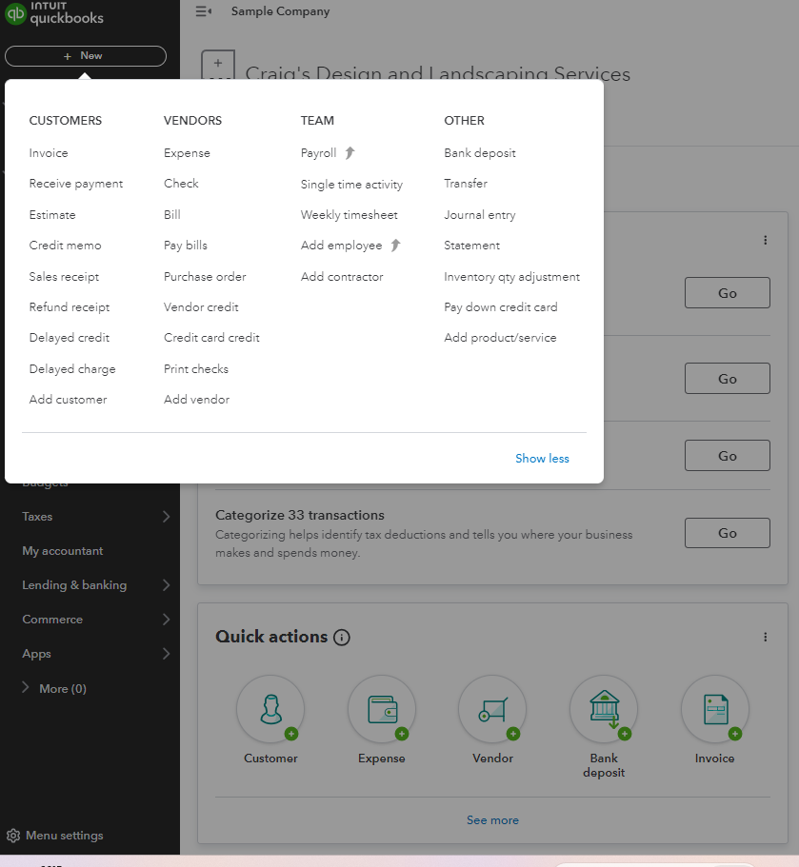
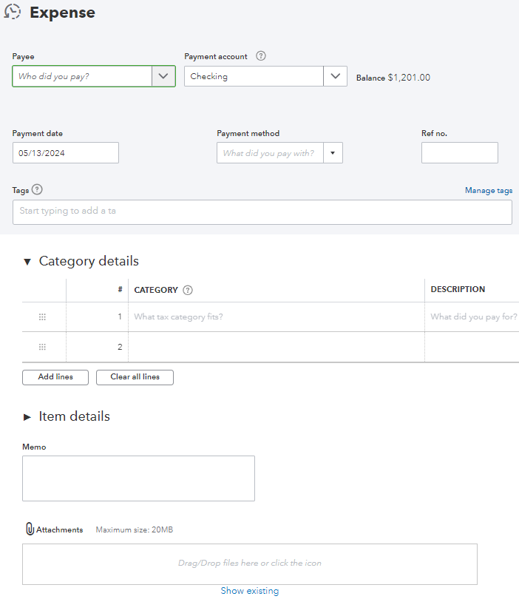
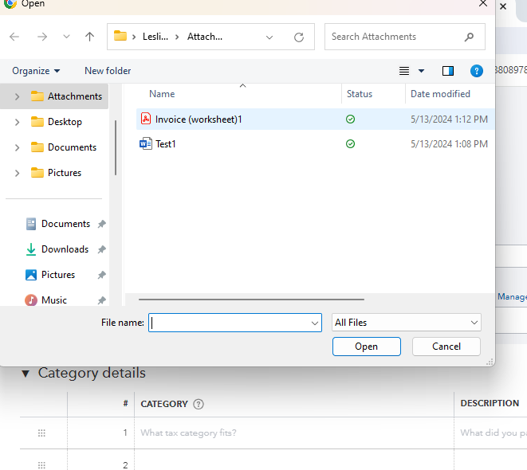

Quickbooks “filing”
Step 1: Select either expense, check, or bill
Step 2: Click the word attachment
Step 3: Locate file, click open
1
2
Step 4: File will appear and is now stored in QBO click if you ever want to view

Slide 11




Employee files
Personnel File
Health and benefits file
I-9 binder/file

Slide 12
Personnel files
-Offer letter/Agreement
-Resume and application
-Performance reviews
-Personnel Action Form
-Time sheets
-Warning documentation
-Employee policy acknowledgements
-Job description
-Resignation letter
-Separation agreement if applicable

Slide 13
Health and benefits file
-Health & Benefits Beneficiary Forms
-Medical, Dental/Vision Plan Elections
-Employee benefit data form
-FMLA Leave Reports
-Workers Compensation
-EEO-1
-Background checks
-Job Related Injuries & Illnesses Records

Slide 14
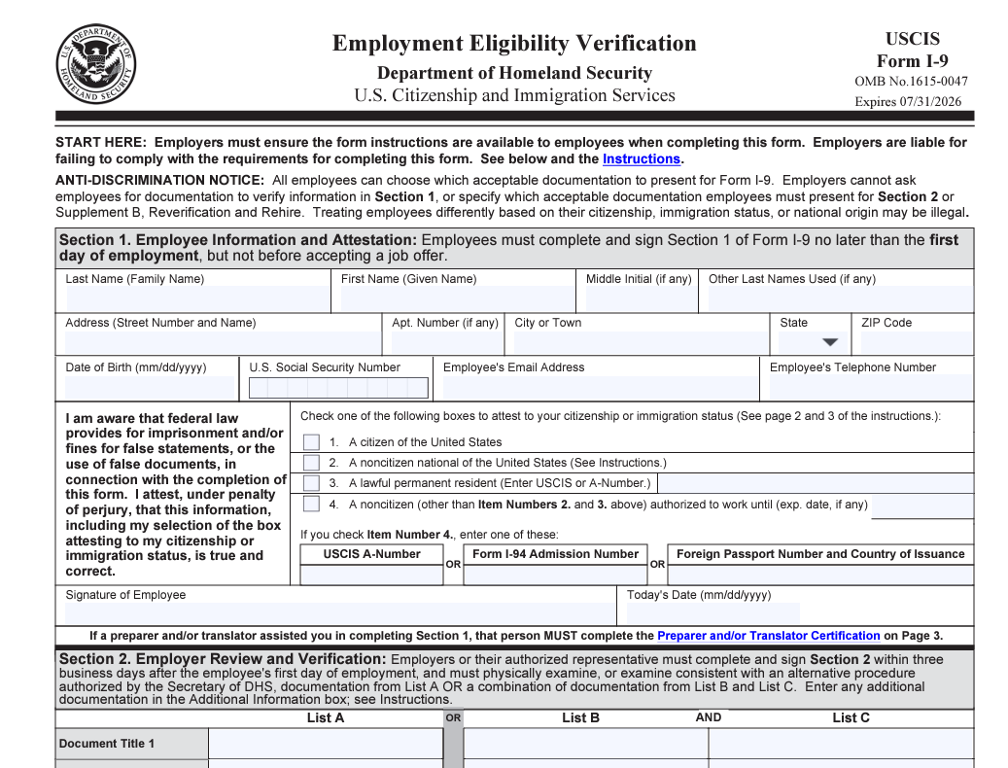
i-9
I-9 should be held in a secure binder
Employers must complete form I-9 to document verification of the identity and employment authorization of each new employee (both citizen and non-citizen)
Visit below link for updated I-9 form
  https://www.uscis.gov/newsroom/alerts/uscis-to-publish-revised-form-i-9

Slide 15
Personnel FORMS to Chancery
o DFR employee benefit data form should accompany any changes in benefits
o Parish should have a documented employer portion/employee portion cost of benefit on file (min 50%)
o Parish should have a documented 403b policy and match (if applicable) on file
These forms should also be filed at the Parish/School

