Slide 1

Business manager
Webex Training – Vendor Management and 1099 Reporting in QBO

Slide 2

1099 Forms
Each year parishes and schools are obliged to report compensation paid to independent contractors to the IRS (with a copy of the forms created sent to the contractor) with a 1099-NEC. (Non-Employee Compensation)
The deadline for filing 1099 forms in QBO is January 28, 2025.
The threshold for issuing 1099-NEC is $600 or more in a calendar year.
What is on a 1099-NEC
  Company name
  Company address
  Payer’s tax ID or EIN
  Recipient’s social security number or EIN
  Total compensation paid to contractor during the year.

Slide 3
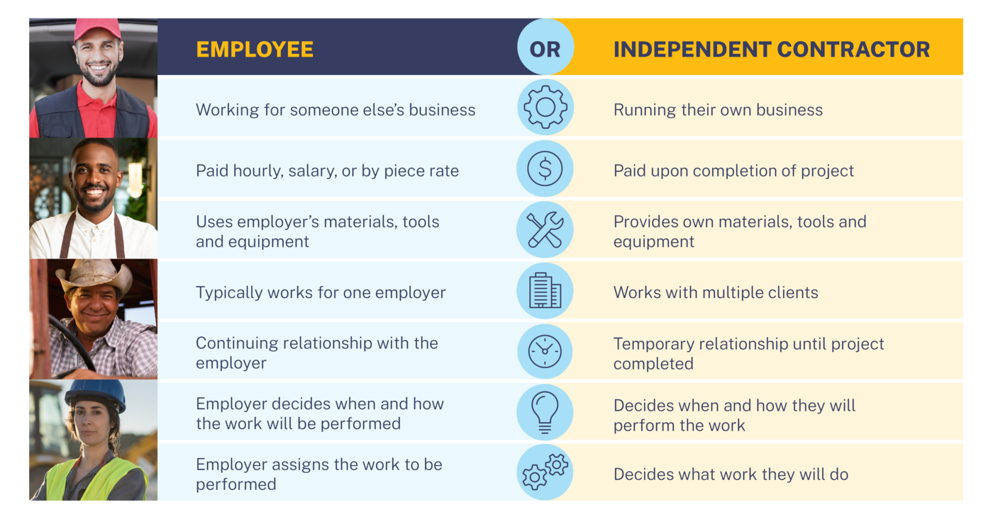
Employee Vs Contractor
What is an Independent Contractor?
An independent contractor is a person or vendor that provides services to a parish or school for a fee (examples include plumbers, landscapers, electricians, and pastors not on the payroll).

Slide 4
Tips to avoid missing Form 1099 deadlines
Best practices to follow:
Keep accurate records: Keep detailed records of your payments to independent contractors throughout the year. It’ll be easier to compile the necessary information when it's time to file your 1099 forms.
Know your specific deadlines.
Get a signed W-9 prior to cutting check and enter information into QBO.
Avoid paying subcontractors in cash.

Slide 5
Helpful Links
W-9 Form and Instructions
https://www.irs.gov/pub/irs-pdf/fw9.pdf
https://www.irs.gov/pub/irs-pdf/iw9.pdf
QBO Video on how to create 1099s
(24) QuickBooks Online 2024: Prepare 1099 Forms – YouTube
How QuickBooks prepares your 1099s
Independent Contractors and 1099s information sheet under policies and procedures
Office of Finance - Roman Catholic Diocese of Fall River

