Slide 1

Business manager
Webex Training – Important Documents

Slide 2

Training overview
Important Documents
501 (c)(3)
MA ST-2
MA ST-5
Federal W-9

Slide 3

USCCB Group Exemption
501 (c) (3)
The United States Conference of Catholic Bishops (“USCCB”) is the central organization holding a group exemption letter for Catholic religious, charitable, and educational organizations in the United States. The USCCB group ruling establishes that Catholic organizations in the U.S. that are listed in the current edition of the Official Catholic Directory are recognized as exempt from federal income tax and described in section 501(c)(3) of the Internal Revenue Code.
To prove you are exempt from federal income tax you will need to supply proof that you are part of the group exemption provided by the IRS. In order to do that you will need to supply a copy of the letter from IRS to USCCB stating you are exempt.
You will also need to supply a copy of the Official Kenedy Directory showing you are part of the group exemption.
Link to the group exemption for the USCCB
0870_001.pdf
Link to the Kenedy Directory
2022-Official-Kenedy-Directory.pdf

Slide 4

MA ST-2
In order to be exempt from sales tax in Massachusetts you need to have an active ST-2 on file. All parishes and schools should already have this.
Exempt Certificates are valid for ten years. Assuming there are no changes in the organization, DOR will issue a renewal notice approximately thirty days prior to the expiration date. If you do not receive one you can give them a call.
There have been instances when the renewal notice was received, the MA taxpayer ID # was different from the original letter. The Commonwealth of Massachusetts advises to go with the most recent letter. The exemption number on the initial letter is the Federal ID# and the latest letter is the Massachusetts account number. Mass DOR can trace back to your account with either number.

Slide 5
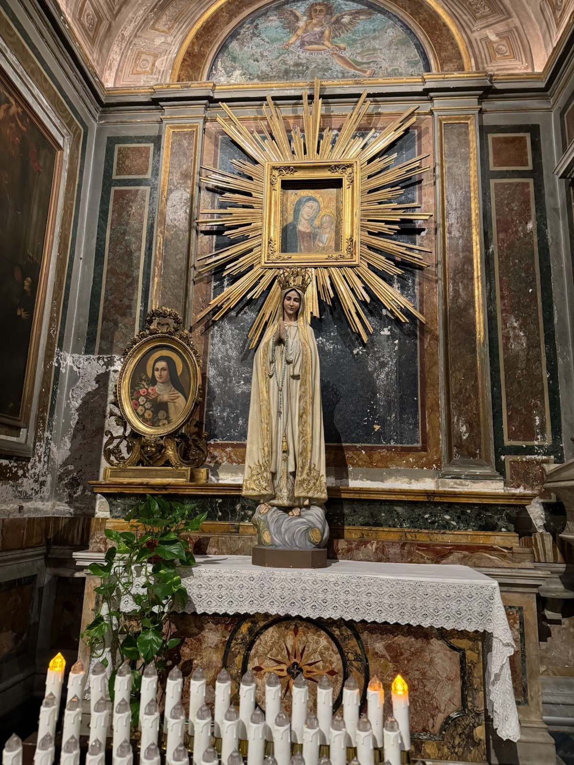
MA ST-5
Massachusetts encourages exempt organizations to submit to the vendor a properly completed Sales Tax Exempt Purchaser Certificate (Form ST-5) with a copy of its Form ST-2 attached.
If you have any questions on completing the form you may call Massachusetts DOR.
Link for MA ST-5 form: ST-5
MA DOR contact is 1-800-392-6089 or 617-887-6367.

Slide 6
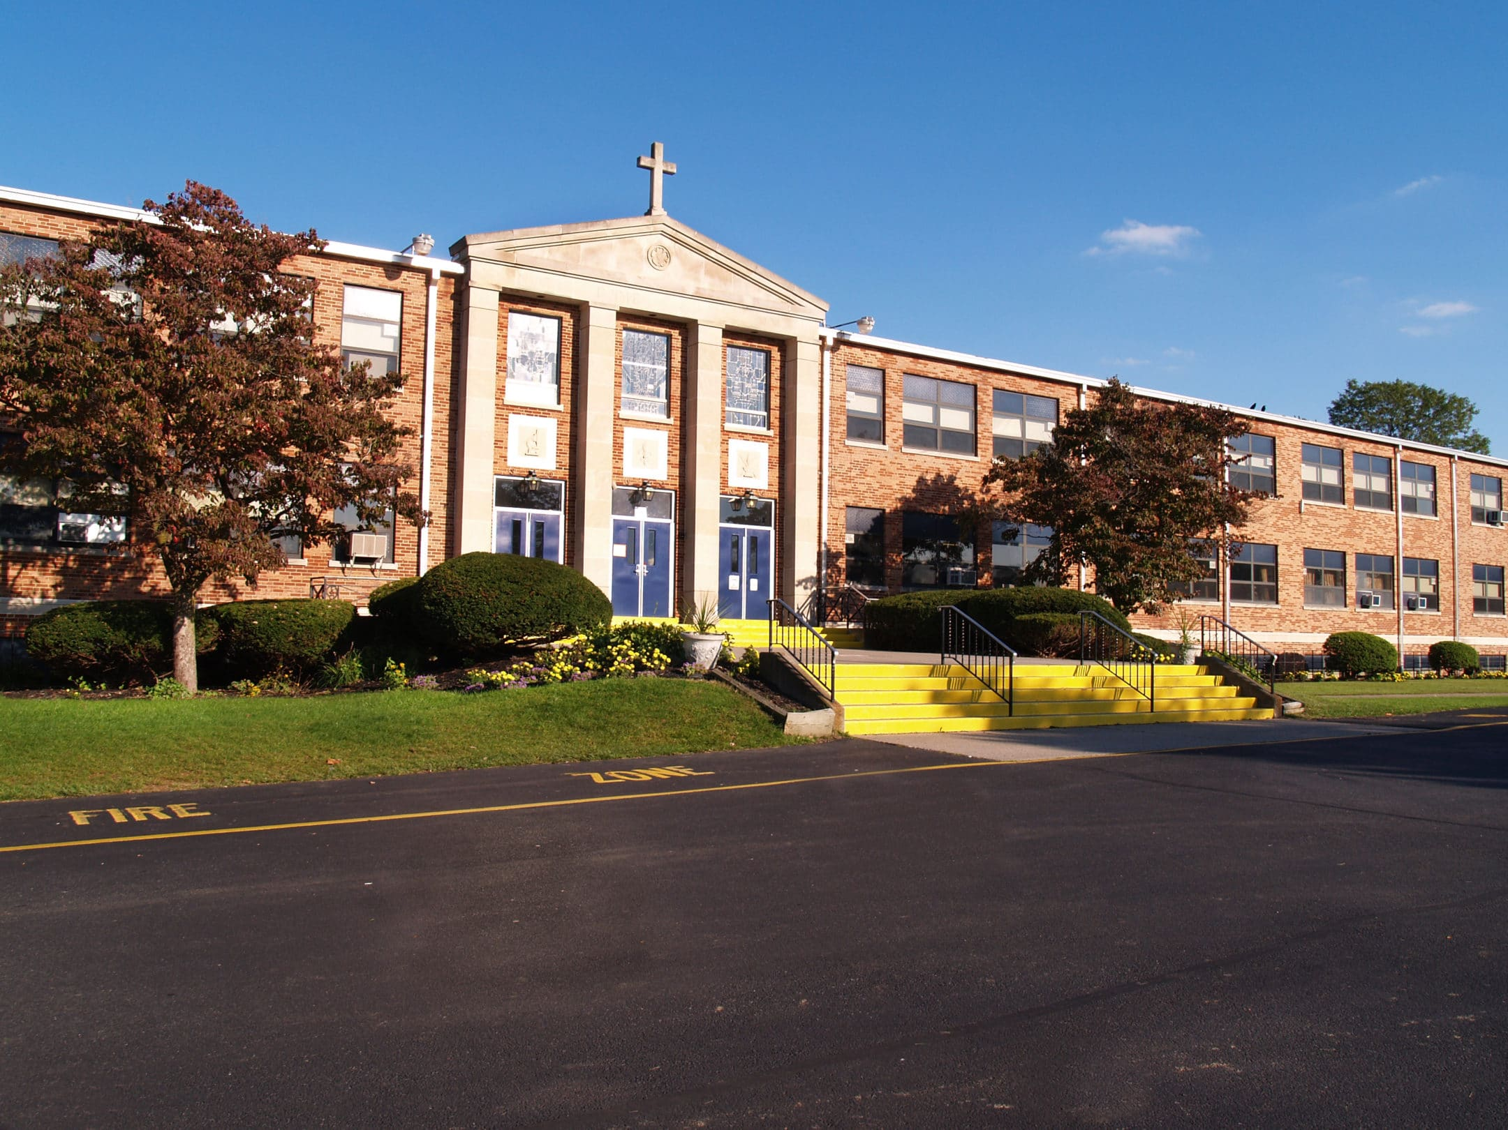
W-9
Form W-9, Request for Taxpayer Identification Number and Certification is used when a person or entity is required to report certain types of income.
Gather tax information (W-9) from a vendor when a parish or school pays a non-employee or other entity $600 in a calendar year.
This form helps you obtain important information from payees so you can prepare a 1099 return for the IRS.
Link to the W-9 form from IRS
  Form W-9 (Rev. March 2024)

Slide 7
Helpful Links
Who to contact in Finance
Chancery-Office-Contacts-rev-10-23.pdf (fallriverdiocese.org)
Diocesan Offices & Ministries contact
A-Z List of Diocesan Offices & Ministries - Roman Catholic Diocese of Fall River (fallriverdiocese.org)
Where to find previously held business manager Webex
Office of Finance - Roman Catholic Diocese of Fall River (fallriverdiocese.org)

